Slide 1
Jenkins Configuration

Slide 2
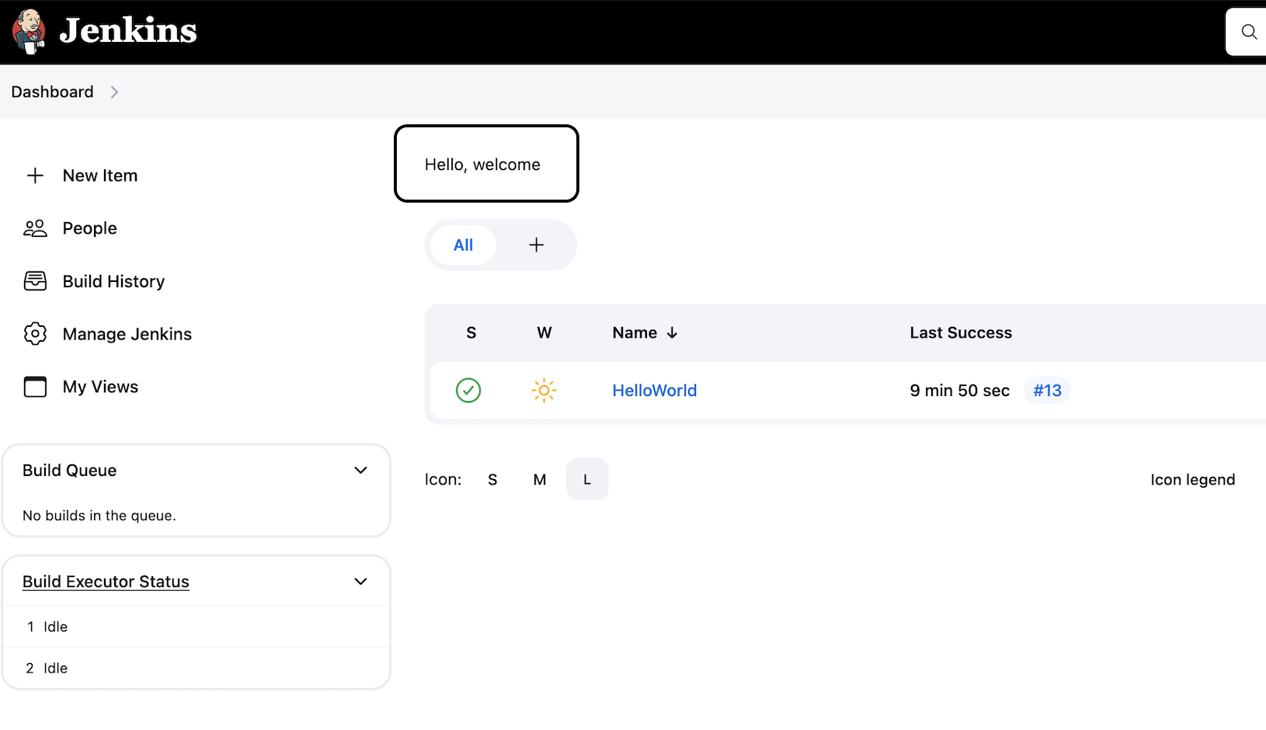
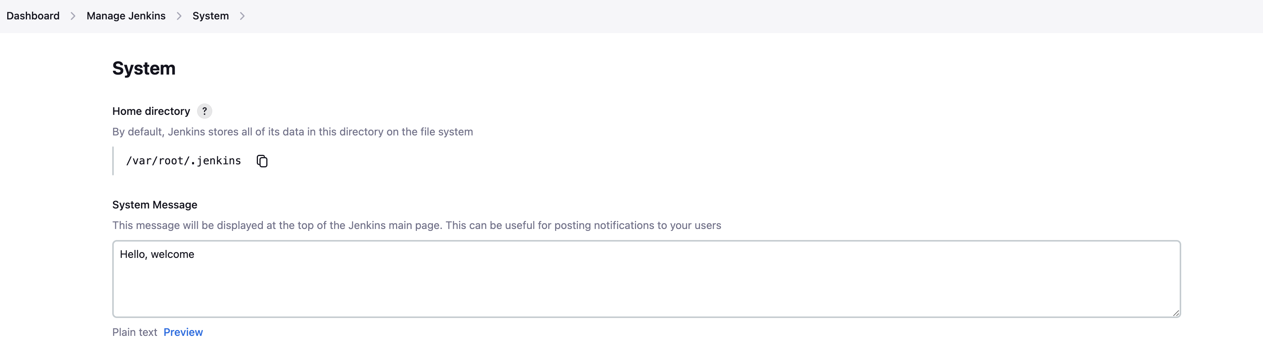
Basic configurations
Step 1 : Goto Manage Jenkins - Configure System
Step 2 : Get a basic understanding of common/basic configurations

Slide 3
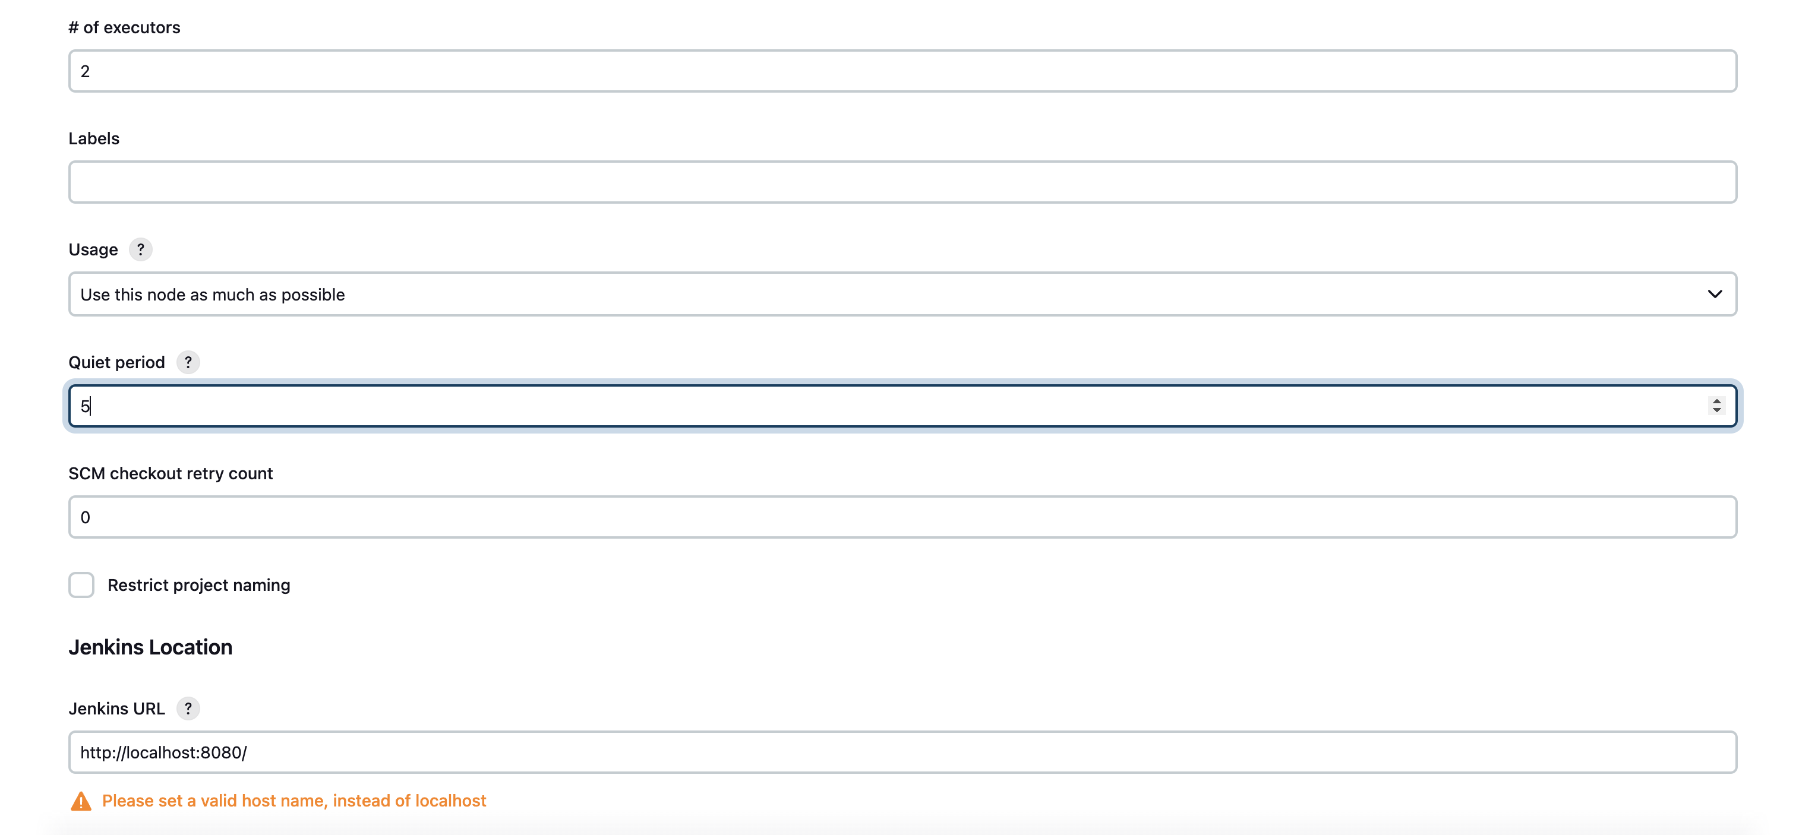

Slide 4
Number of Executors:
Executors in Jenkins are essentially worker threads that perform build jobs.
The "Number of Executors" configuration allows you to specify how many concurrent builds Jenkins can run at the same time.
This setting is important for controlling resource utilization on your Jenkins server. You can set the number of executors based on the available hardware resources and the workload of your Jenkins server.
Labels:
Labels in Jenkins are used to categorize and organize nodes (agents) in your Jenkins environment.
You can assign labels to nodes based on their capabilities, such as specific tools installed, operating system, or hardware configuration.
When configuring a job, you can specify a label requirement, and Jenkins will only run the job on nodes that have the matching label.
Usage:
The "Usage" configuration allows you to control how Jenkins utilizes the available nodes (agents) in your Jenkins environment.
Jenkins provides different options for usage, such as "Only build jobs with label expressions matching this node" or "Build jobs with label expressions matching this node and leave this machine for tied jobs only."
This setting helps you define the workload distribution across different nodes based on their labels and capabilities.
Quiet Period:
The "Quiet Period" configuration introduces a delay before Jenkins starts building after a new commit or trigger event.
It allows for a grace period during which additional changes can be pushed to the repository before Jenkins initiates the build.
This setting helps prevent unnecessary builds triggered by rapid successive commits and gives developers a window to push related changes together.

Slide 5
SCM Checkout Retry Count:
This configuration specifies the number of retry attempts Jenkins makes when checking out source code from the version control system (SCM) before considering the checkout operation as failed.
Sometimes network issues or intermittent errors may occur during the checkout process, and setting a retry count helps Jenkins recover from such transient failures.
Restrict Project Naming:
The "Restrict Project Naming" configuration allows you to define naming conventions for Jenkins job names.
You can specify regular expressions to enforce naming patterns for new jobs created in Jenkins.
This setting helps maintain consistency and organization in your Jenkins environment by ensuring that job names adhere to a predefined format.
Pattern – You can restrict this based on the project name

Slide 6
Jenkins integration with GIT (SCM)
git init
git status
git add .
git commit -m “add file”
Create new repo in github
git remote add origin https://github.com/muthuramanathanm/jenkins-cicd.git
git commit -m "add new file"
git push –u origin main

Slide 7
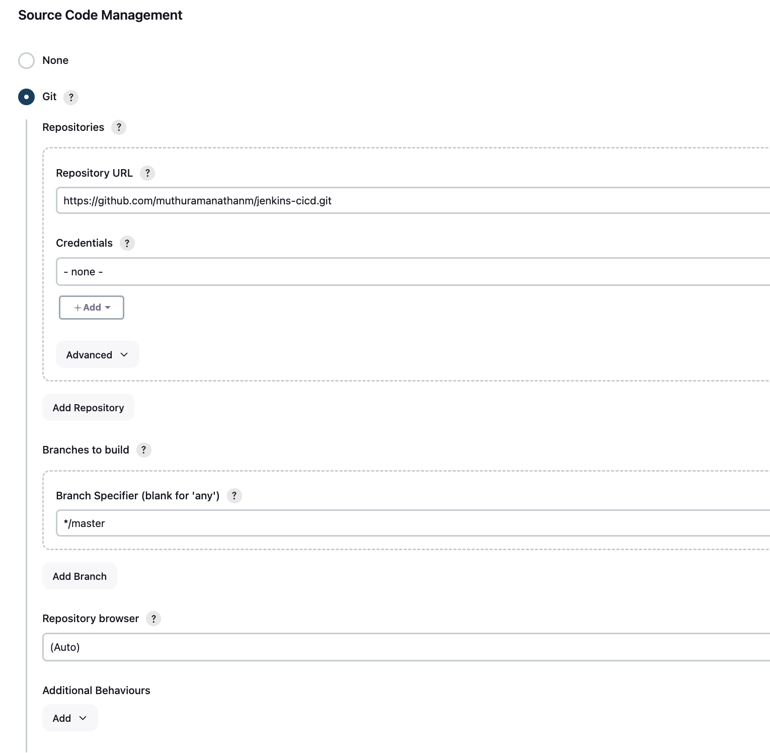
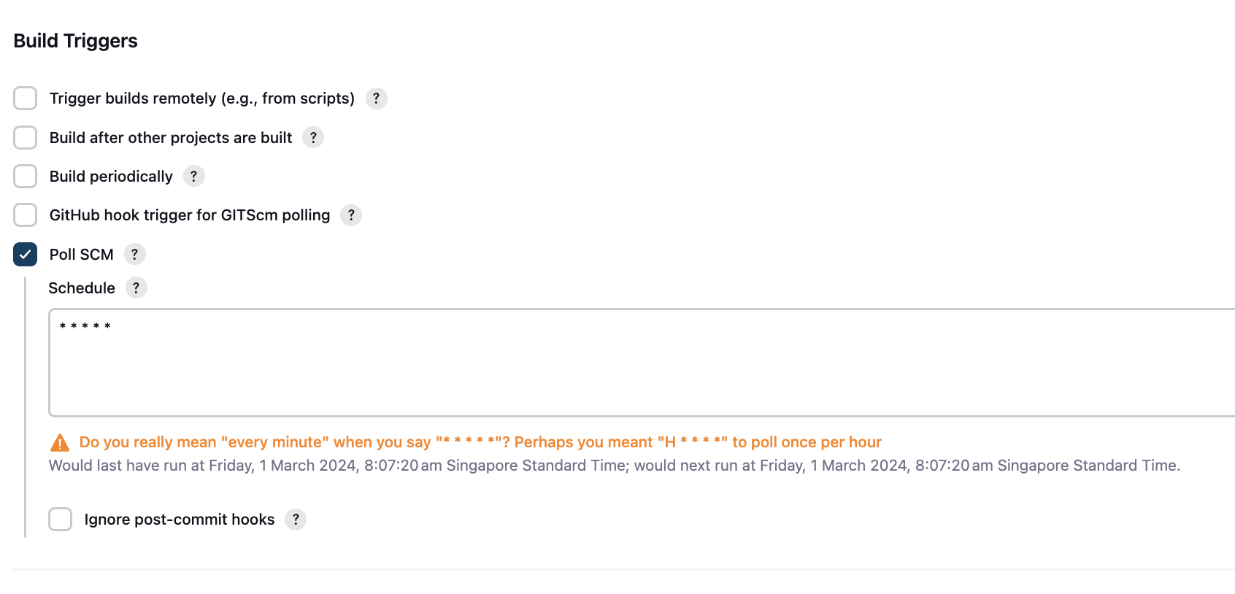

Slide 8
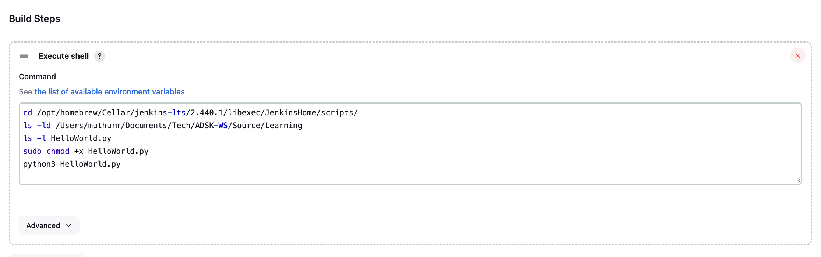
Build Steps:

Slide 9
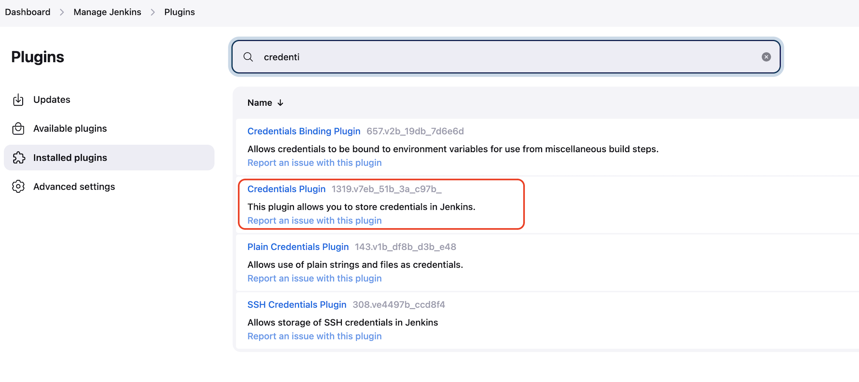
How to add GitHub Credentials
In Jenkins, the "Add GitHub Credentials" option allows you to securely store and manage GitHub-related credentials within Jenkins. These credentials are typically used for authenticating Jenkins with GitHub repositories or services, enabling Jenkins to interact with GitHub APIs, clone repositories, and perform various GitHub-related operations.

Slide 10
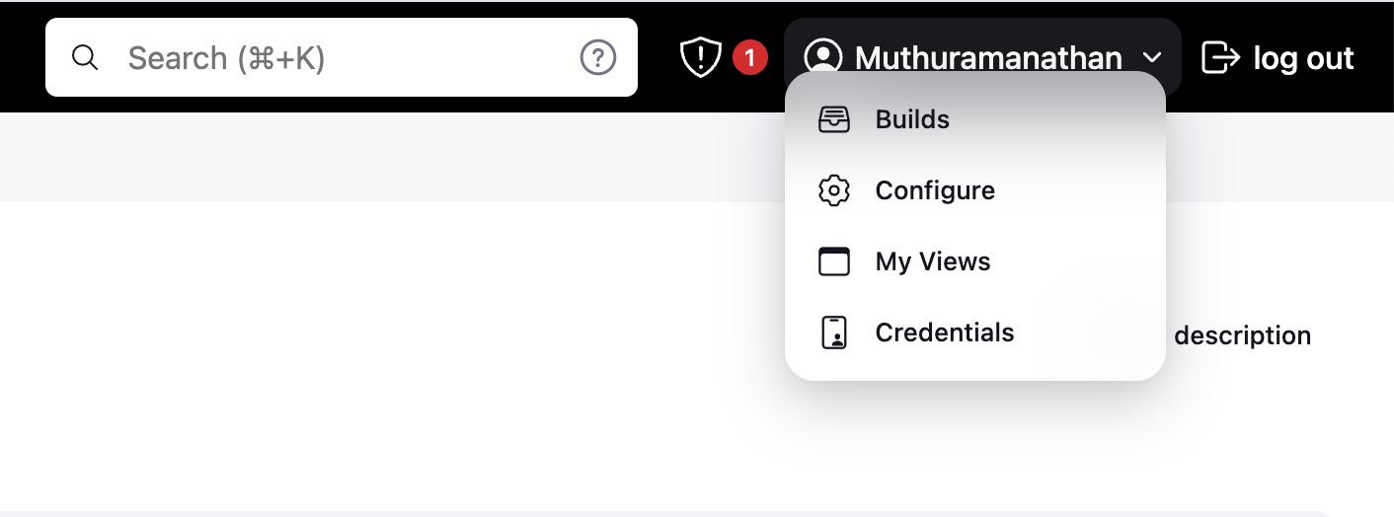
Create credentials:

Slide 11
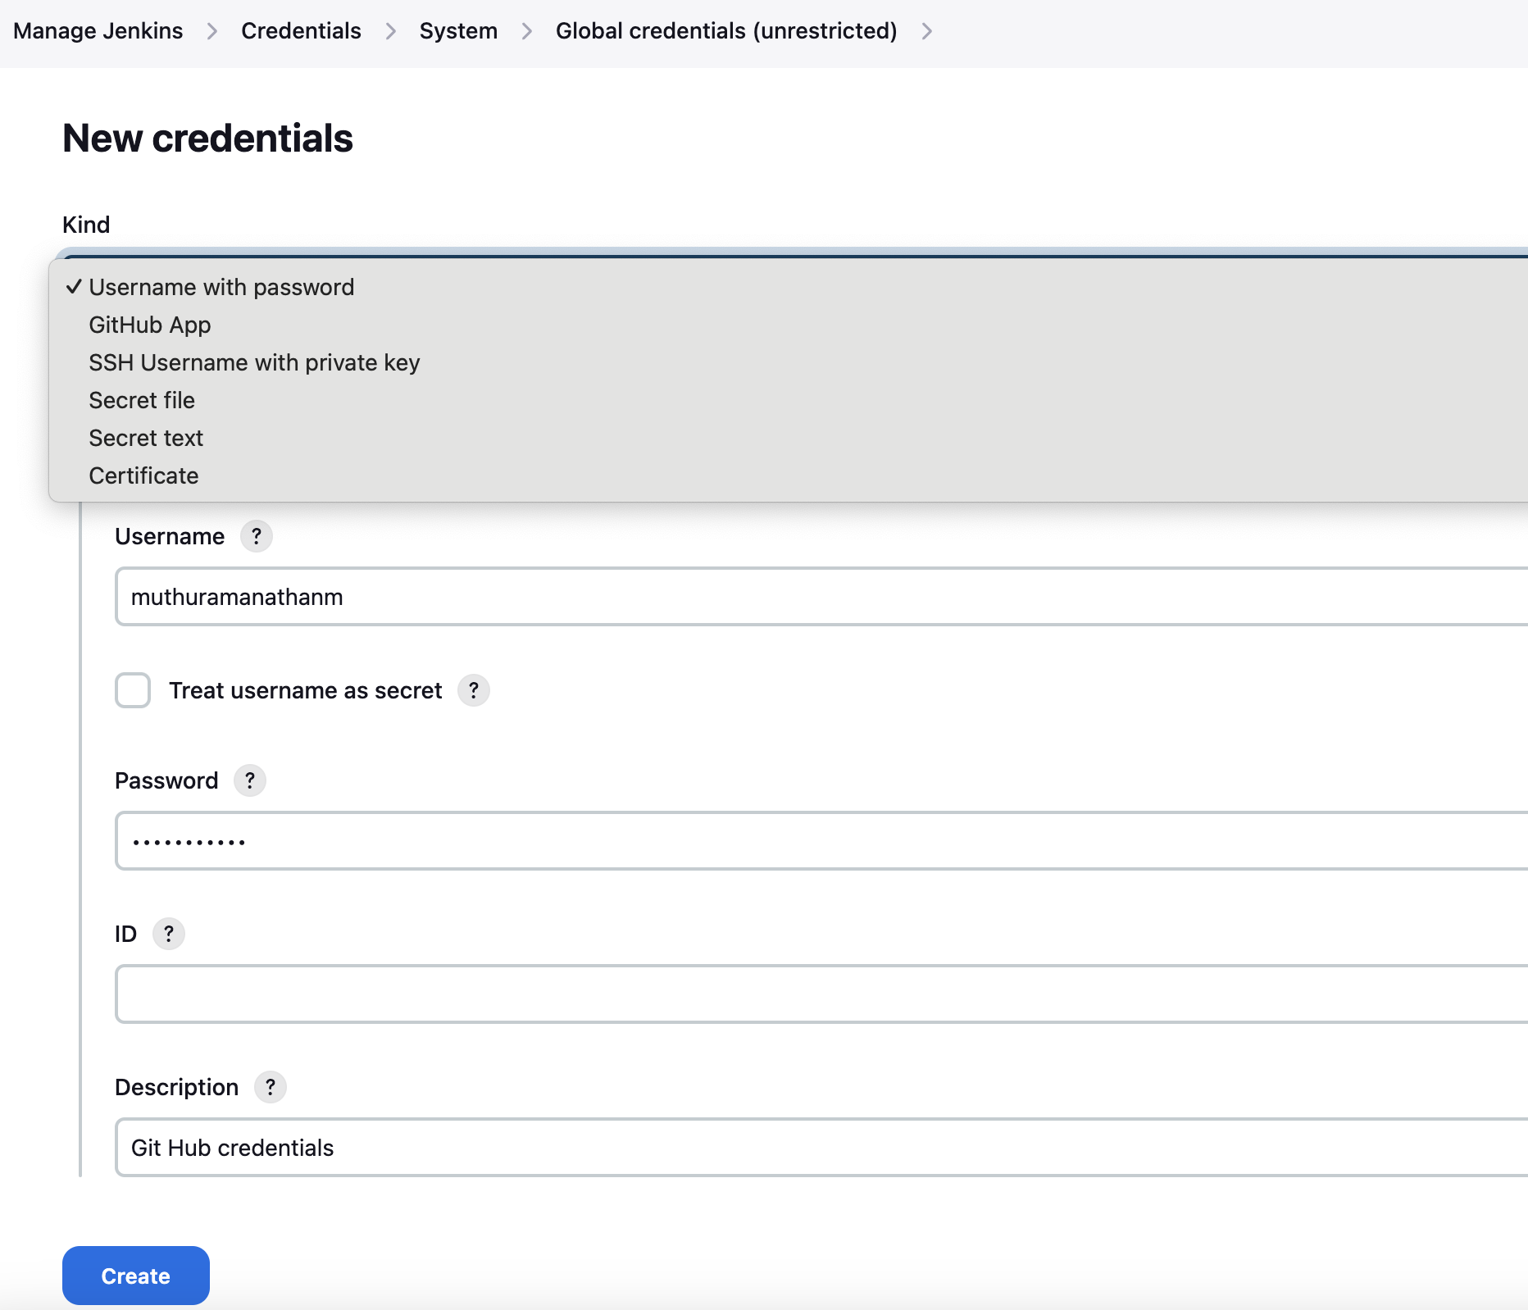
Give GitHub username and password as shown below:

Slide 12
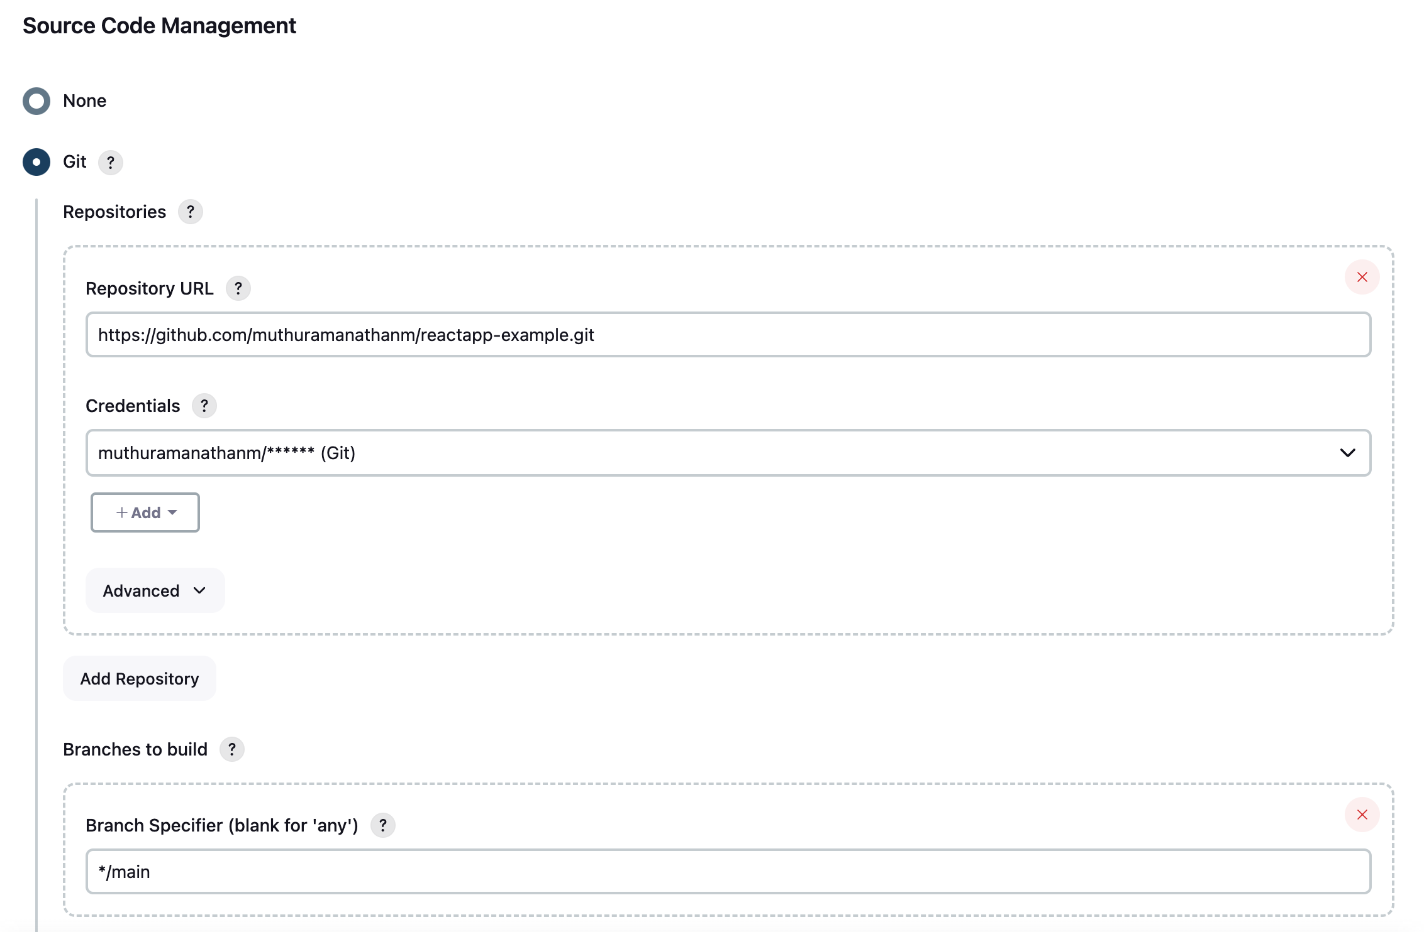

Slide 13
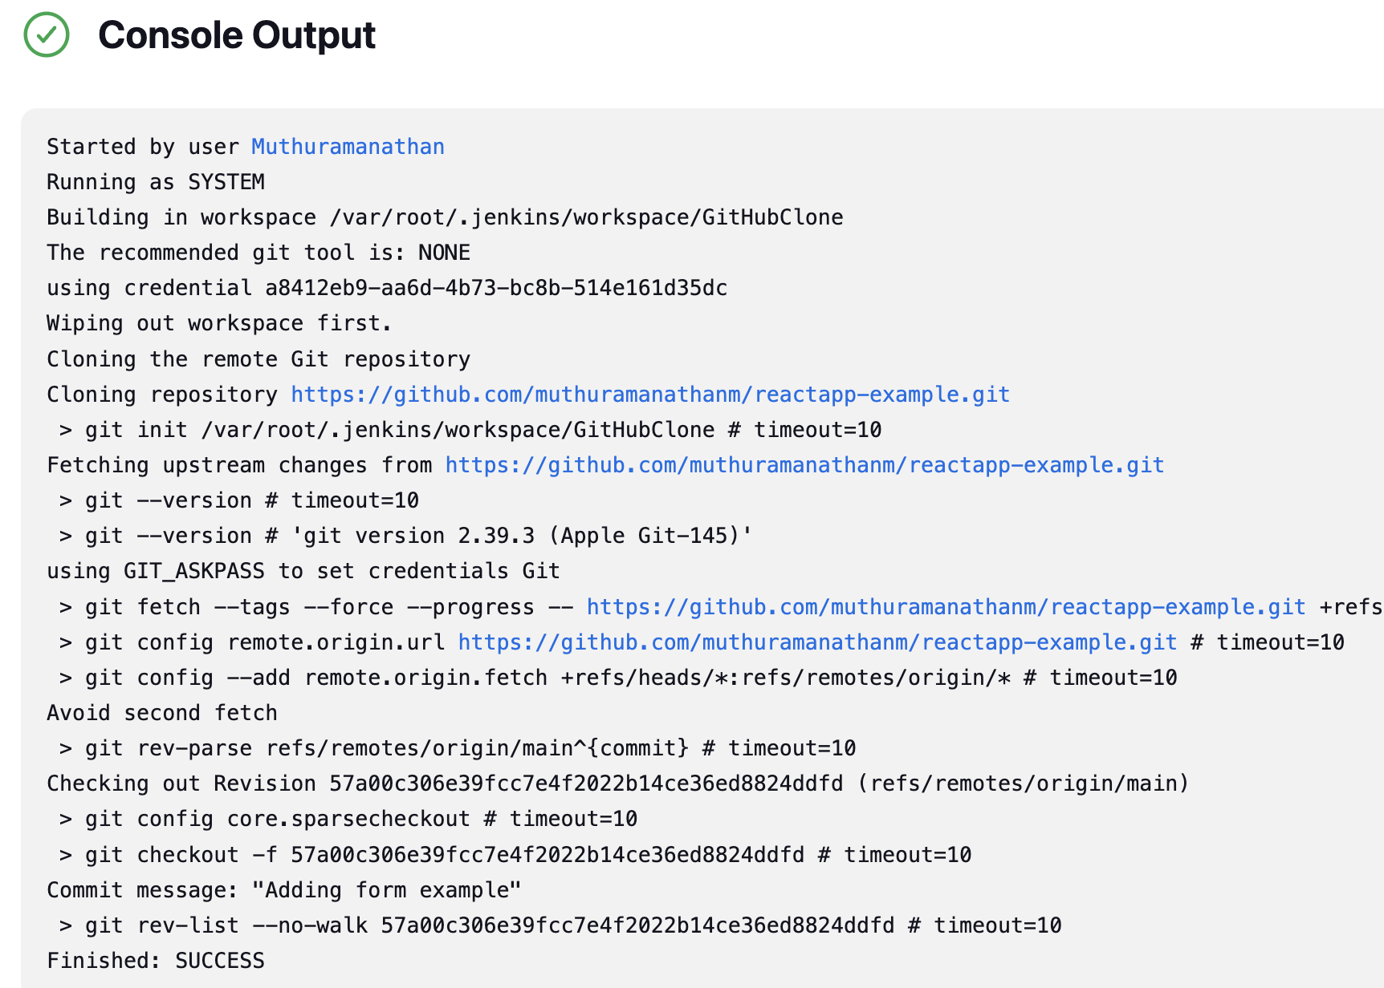
Once you configure then trigger build and the below is the sample output:
By default, it is cloned inside this workspace folder:
/var/root/.jenkins/workspace – Here is the place you can find the installed the files.

Slide 14
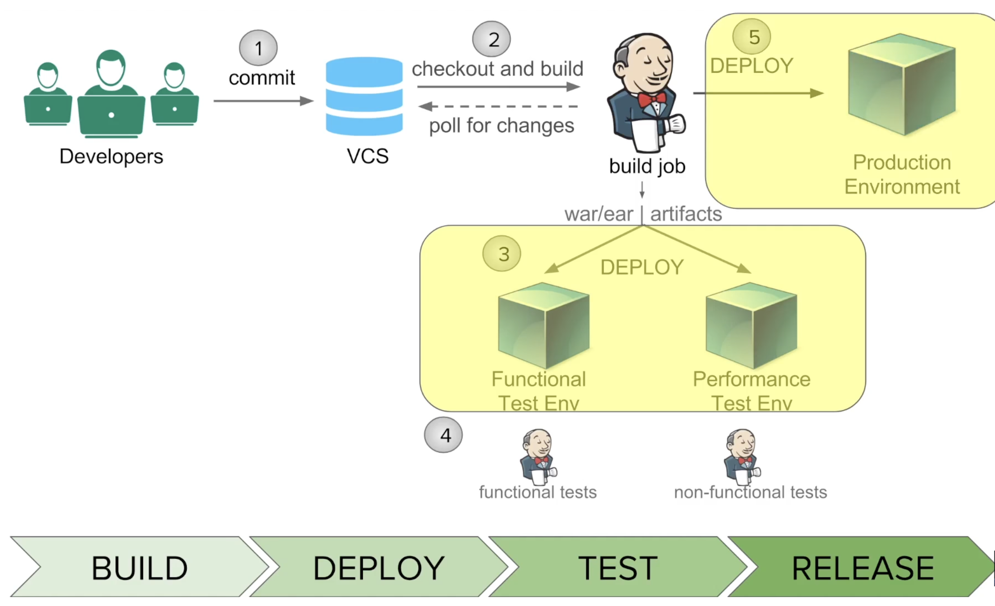
How to do Automated Deployment:

Slide 15
Automated deployment in Jenkins refers to the process of automatically deploying software or applications to various environments (such as development, testing, staging, and production) using Jenkins, which is an open-source automation server. This automation helps streamline the deployment process, reduces manual errors, and ensures consistency in the deployment process across different environments.

Slide 16
Automated pipeline with Python Example:
2 Types of Pipeline:
Declarative pipeline - simplicity, readability, and ease of use. It's recommended for most use cases, especially for users new to Jenkins pipelines or for projects with straightforward pipeline requirements.
Scripted pipeline - more important for teams that require advanced customization, complex pipeline logic, or specific functionality not supported by Declarative Pipeline. It's suitable for experienced users who are comfortable with Groovy scripting

Slide 17
Create New Item -> Enter Project name
Choose pipeline and click Ok
Got to Pipeline section -> select pipeline script
Declarative pipeline script:
Copy the Jenkinsfile from this repo:
https://github.com/muthuramanathanm/jenkins-cicd/blob/master/Jenkinsfile
And directly past in pipeline script as below screenshot and save.

Slide 18
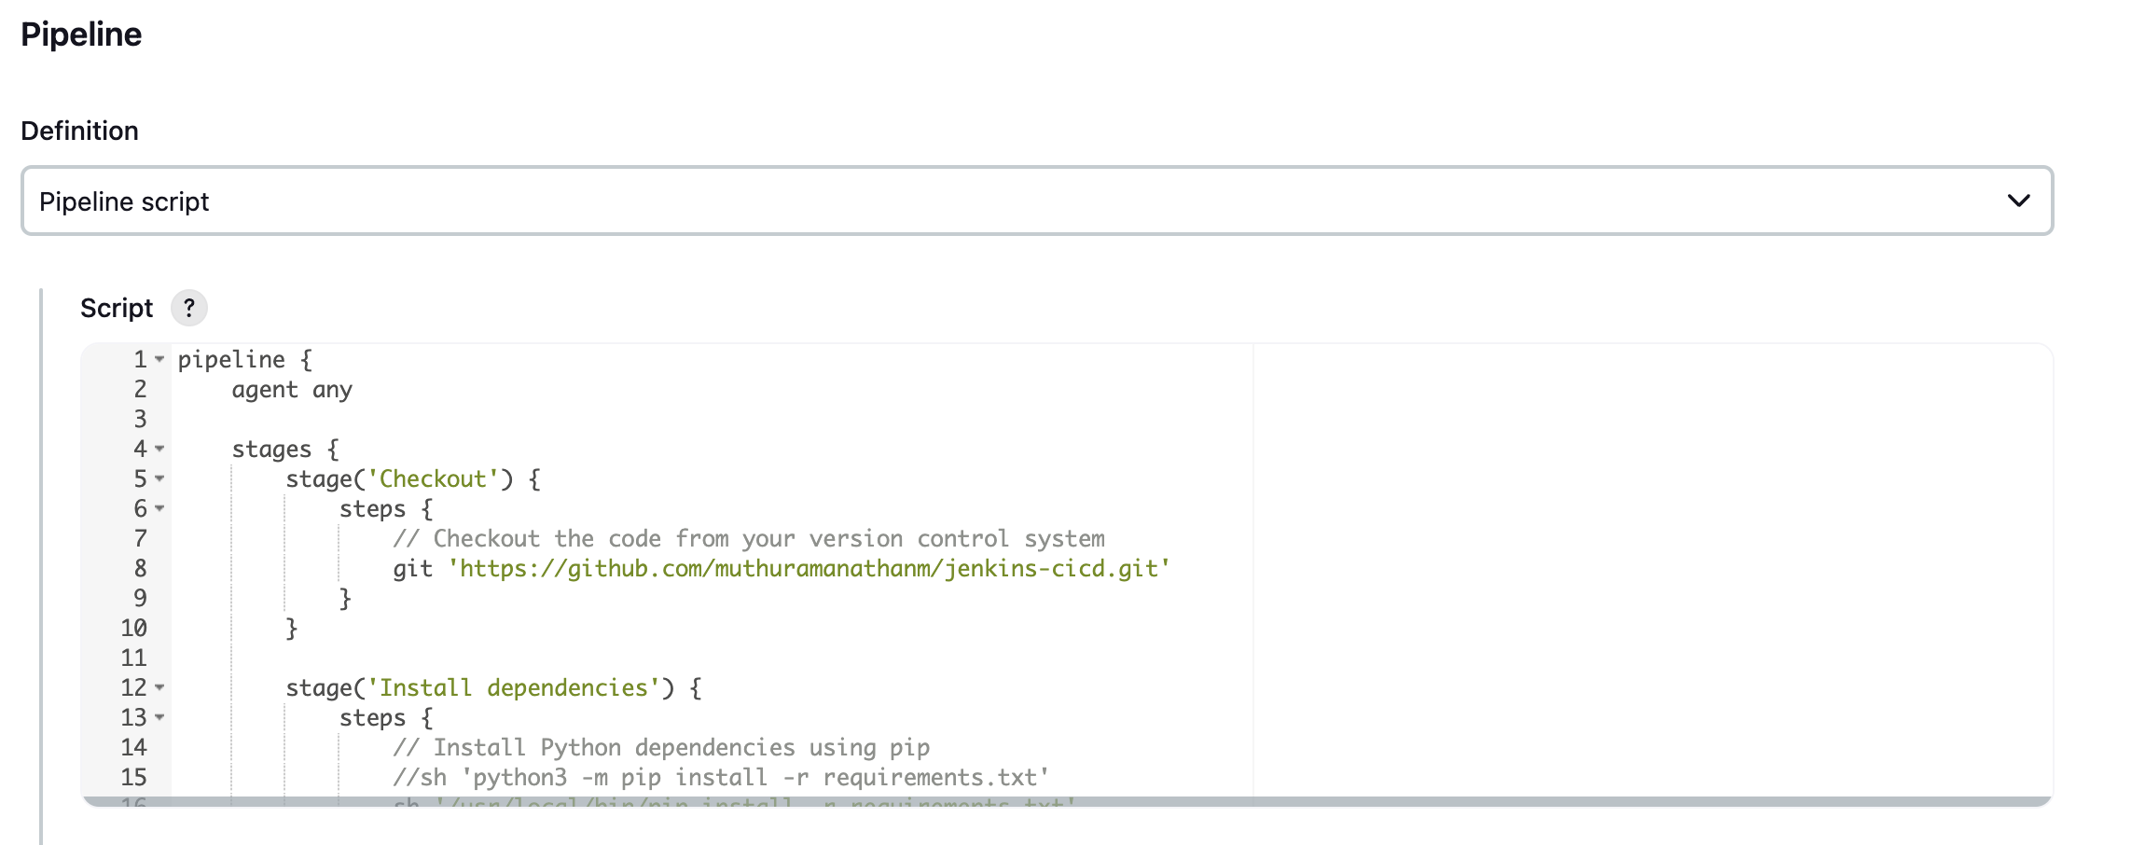
Click on build and Jenkins start

Slide 19
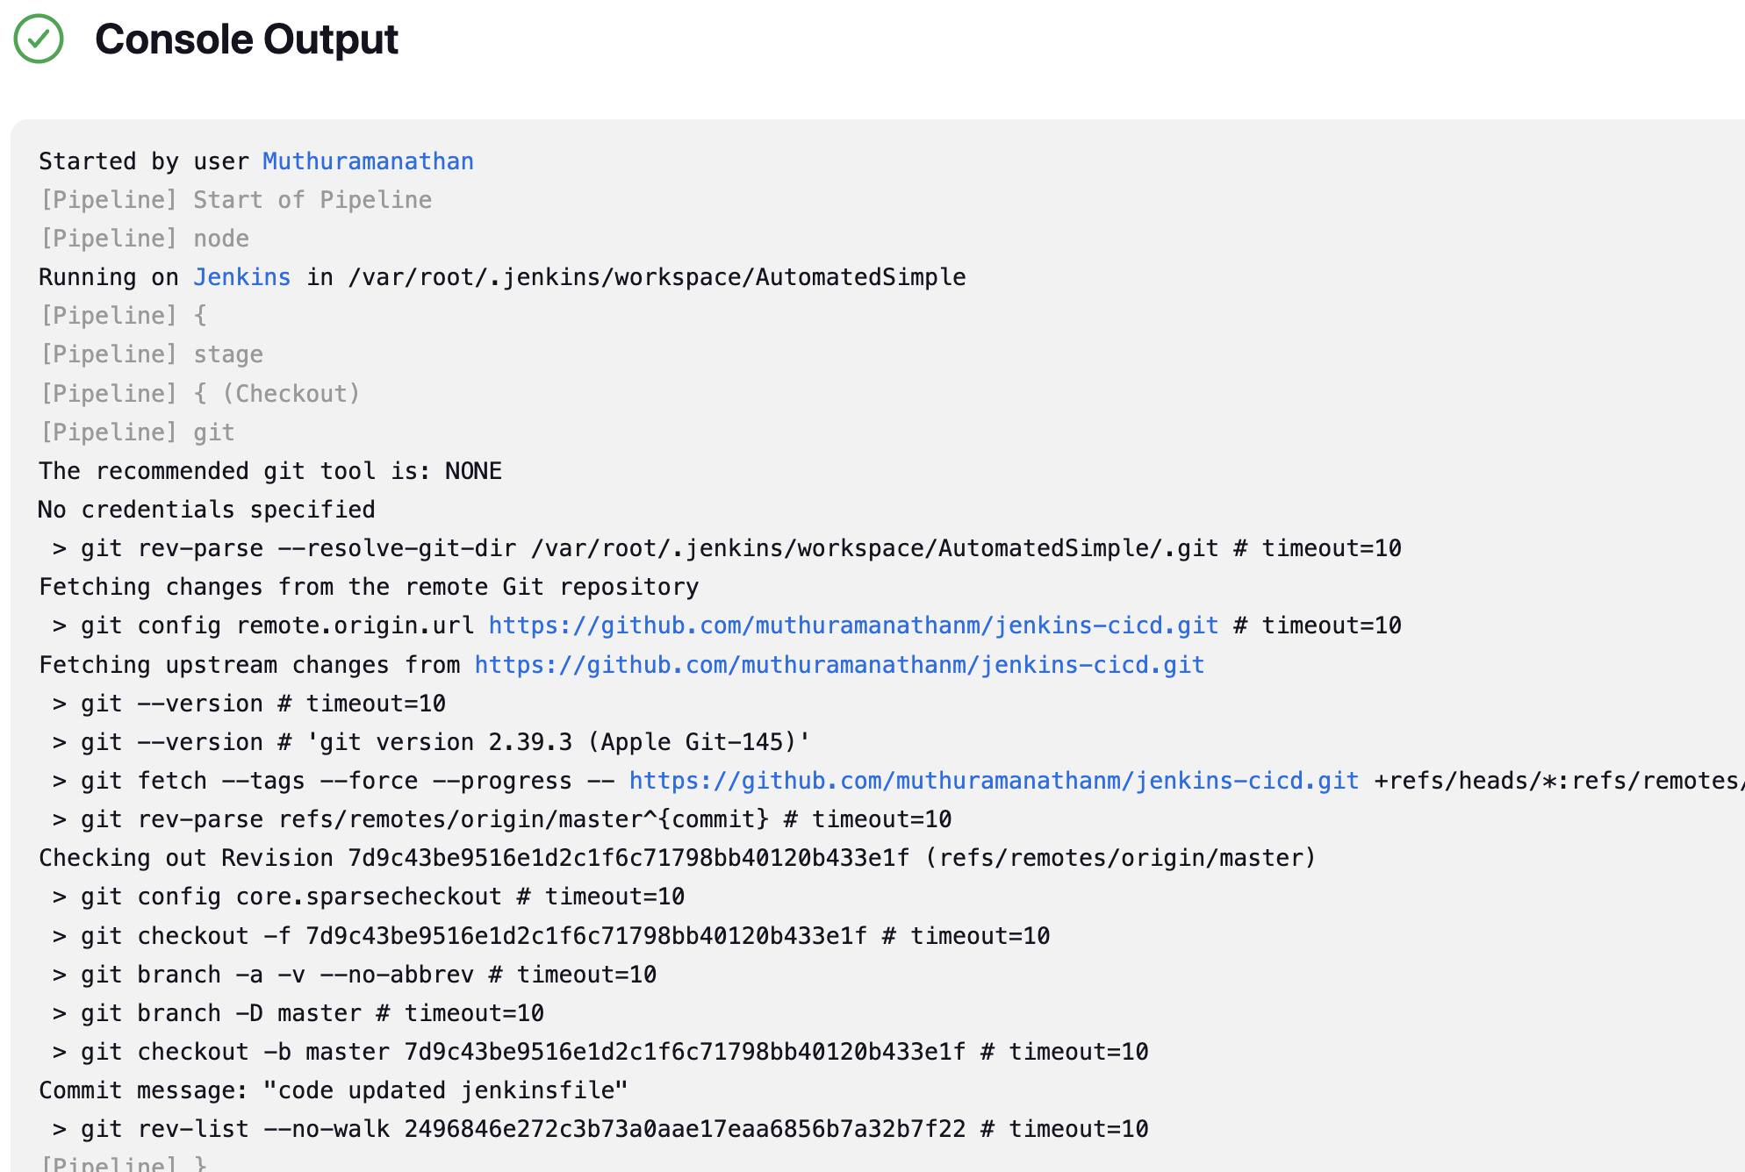
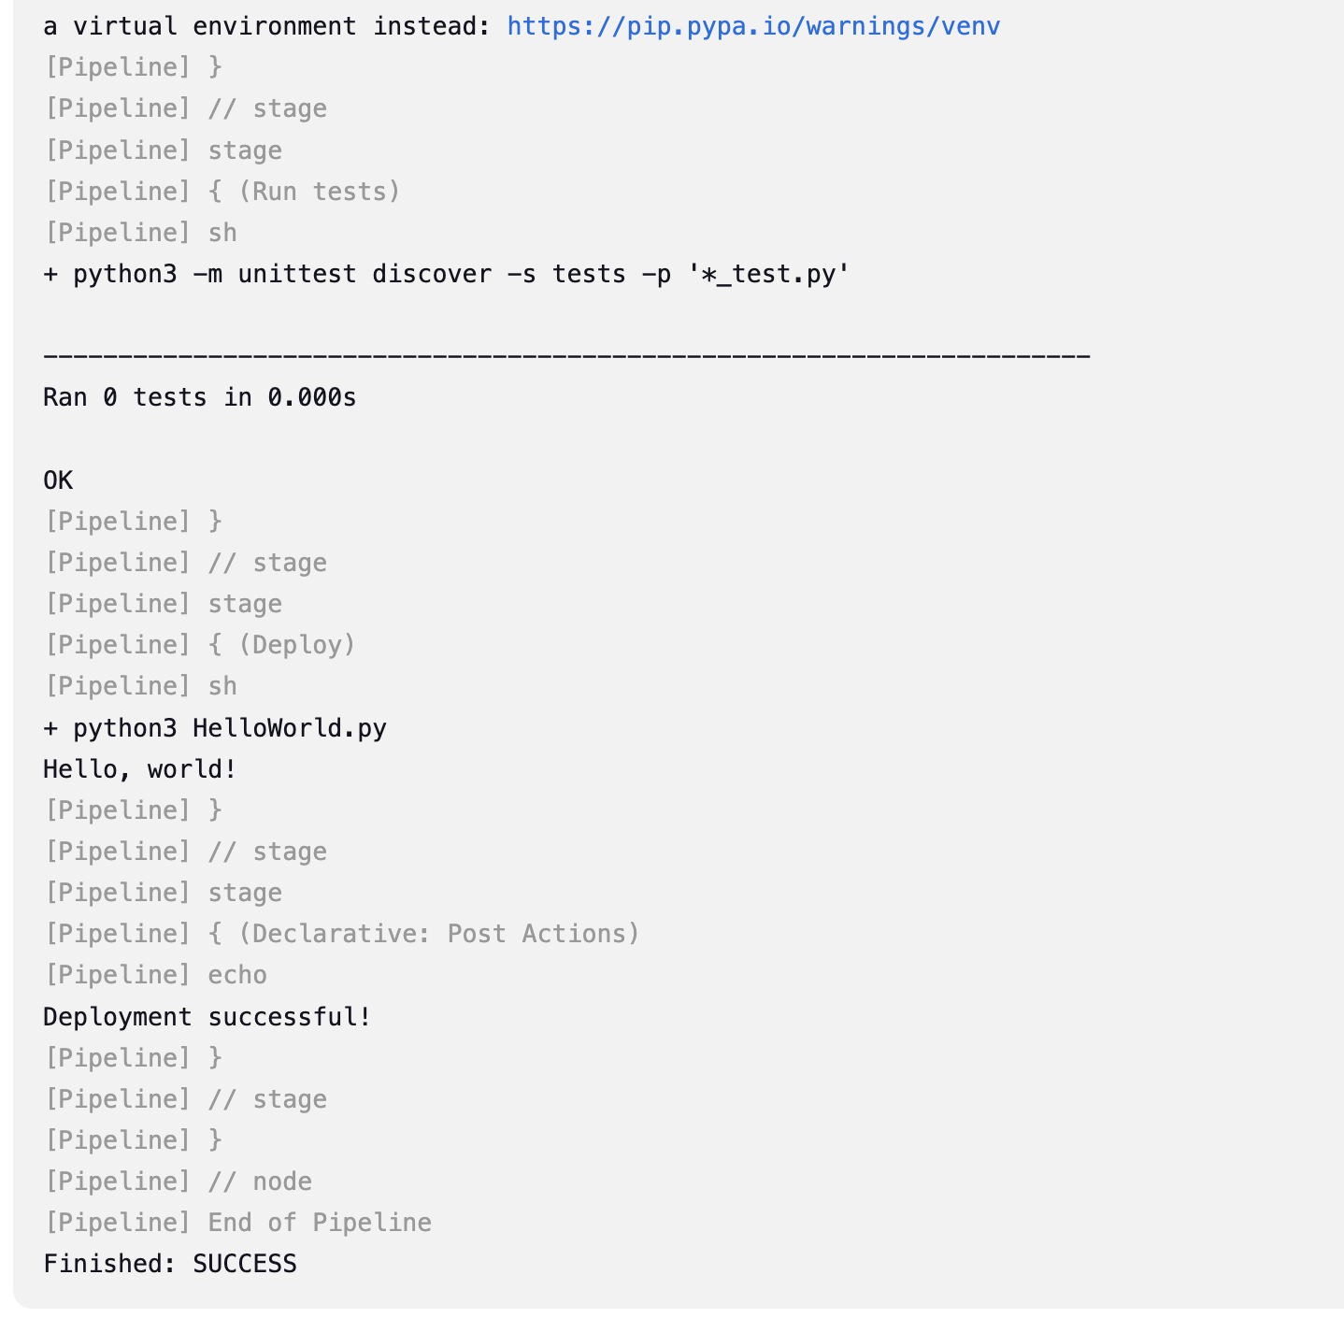
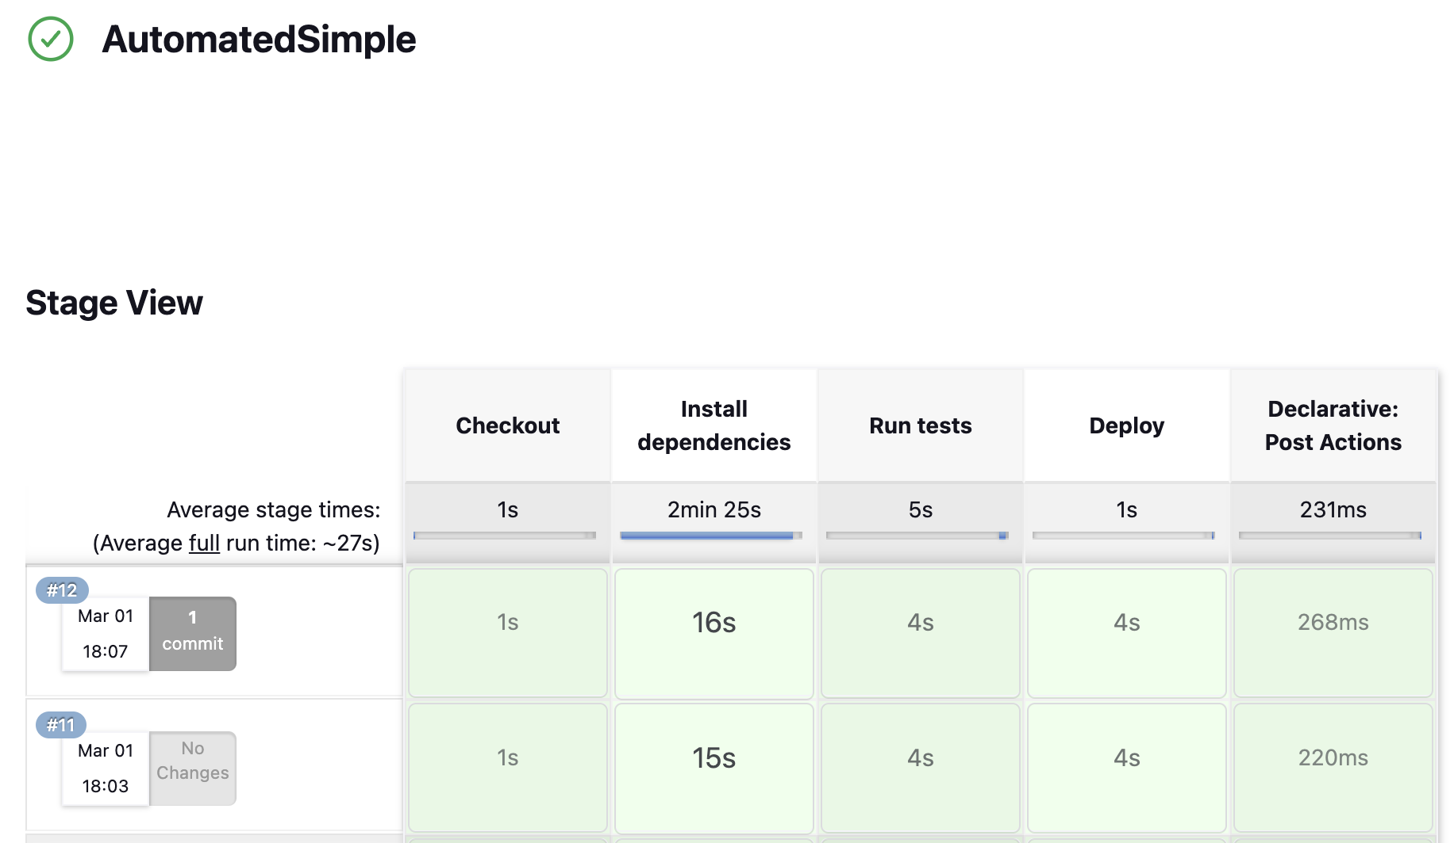

Slide 20
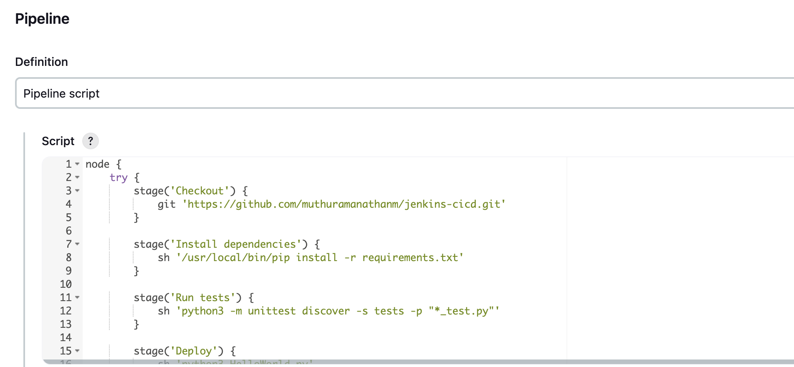
Scripted Pipeline:
Please use the below Scripted pipeline from this Repo:
https://github.com/muthuramanathanm/jenkins-cicd/blob/master/Jenkinsfile_Scripted
And try to paste inside pipeline script and run this build.

Slide 21
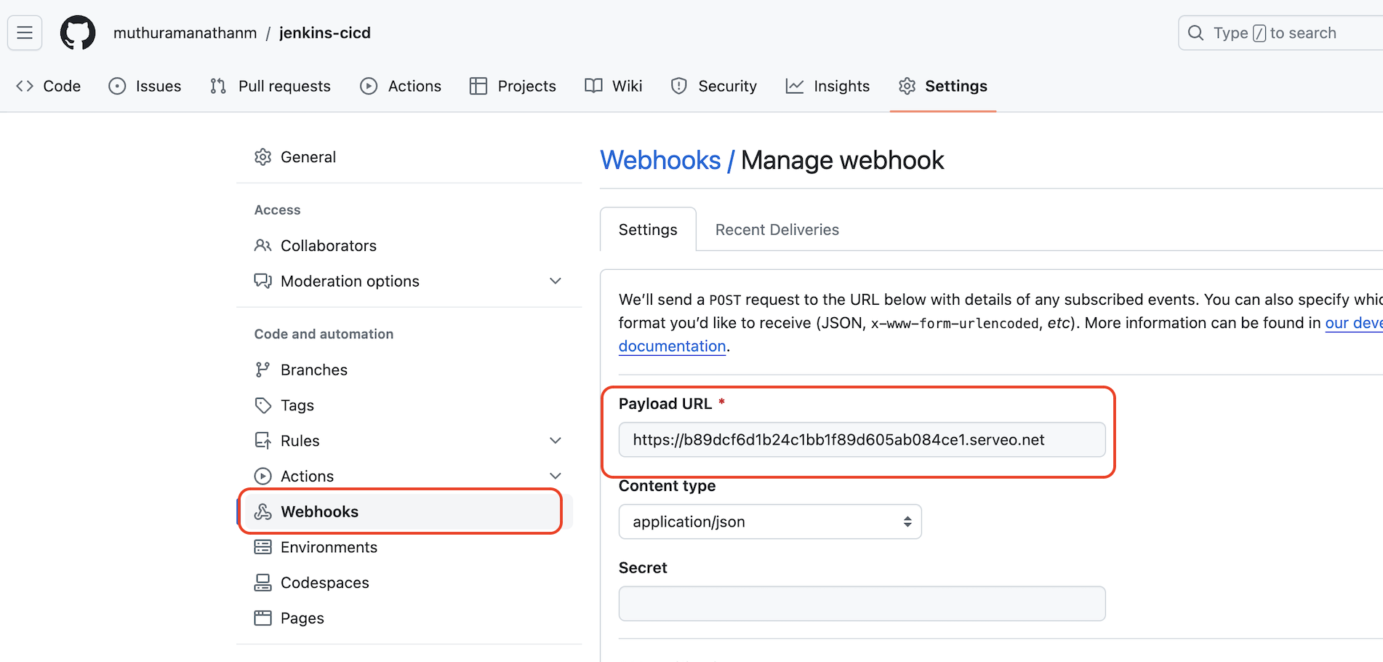
Add webhook:
Whenever push code into repo Jenkins automatically trigger the build and start executing.
http://<public_ip-addr>:8080/github-webhook/
Example:
http://54.87.178.63:8080/github-webhook/

Slide 22
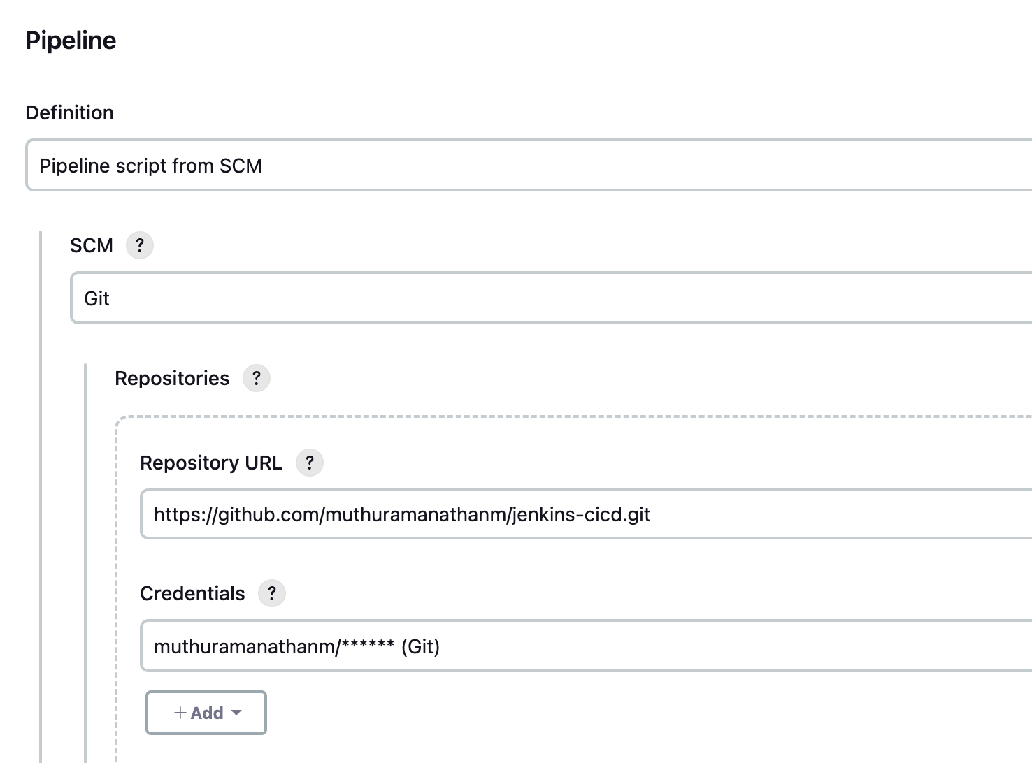
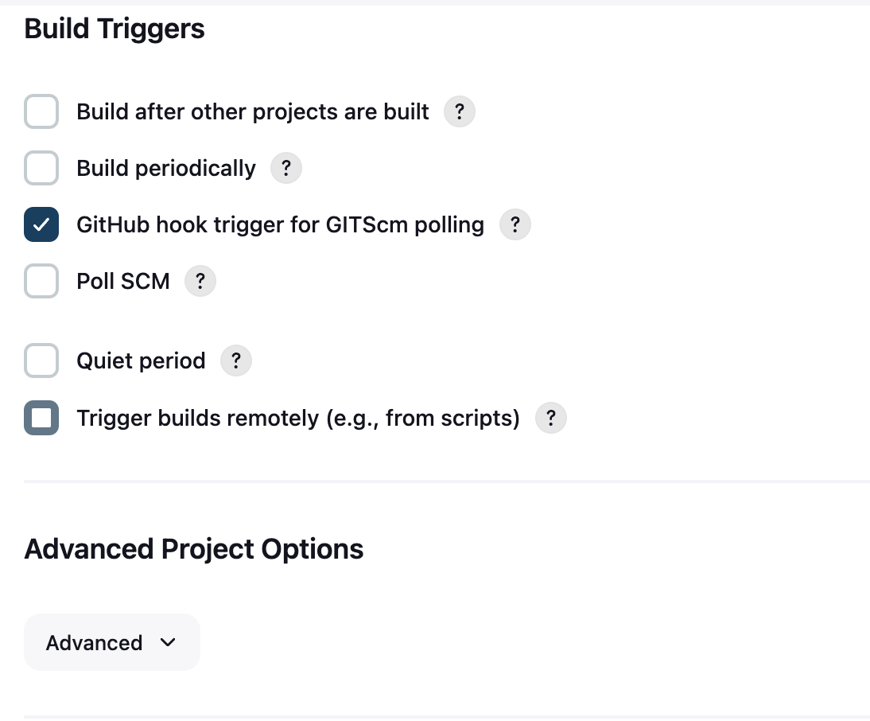
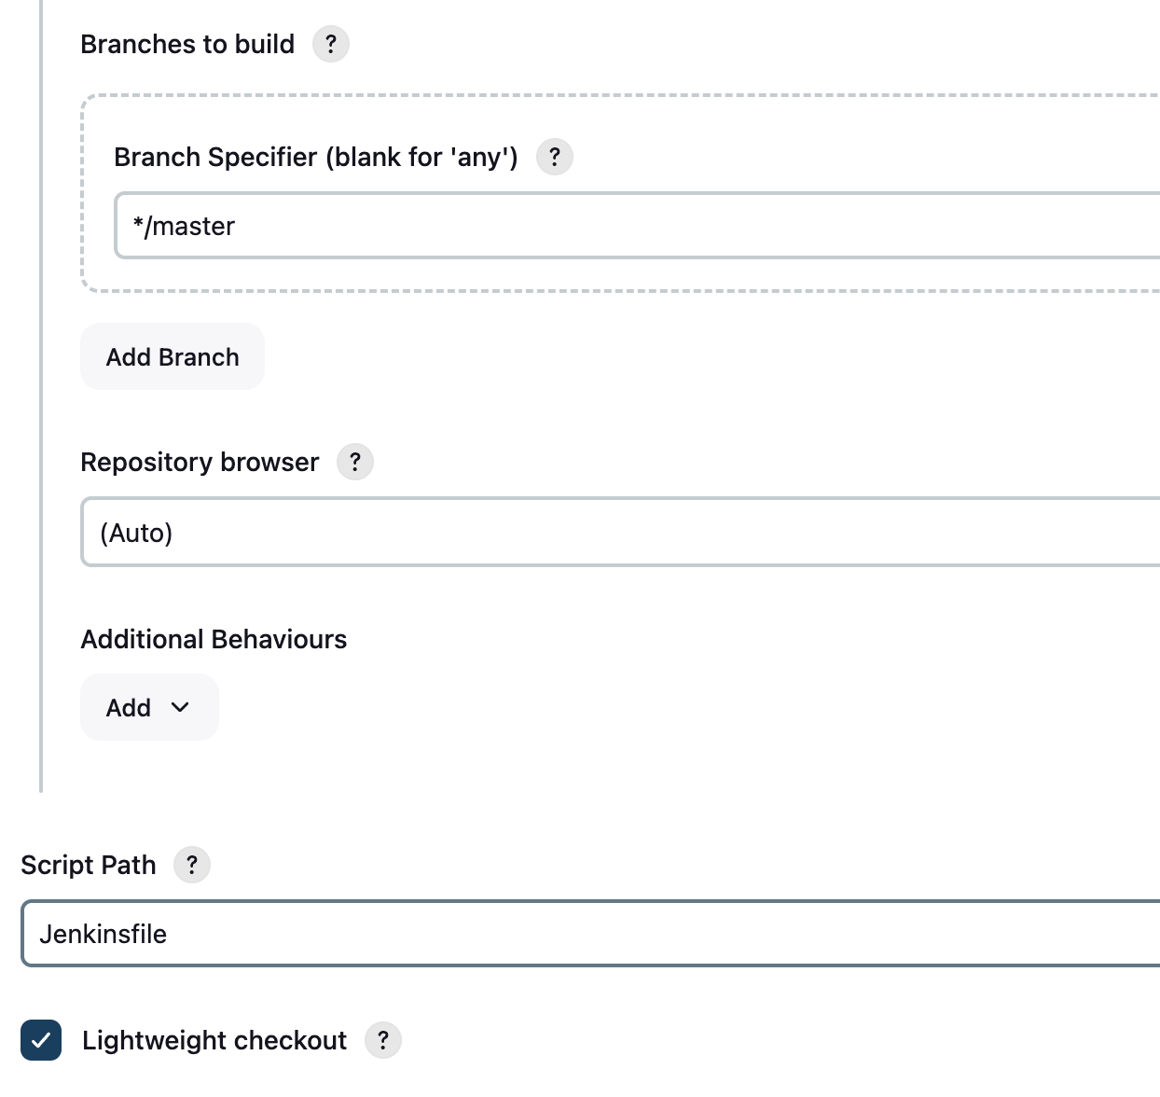
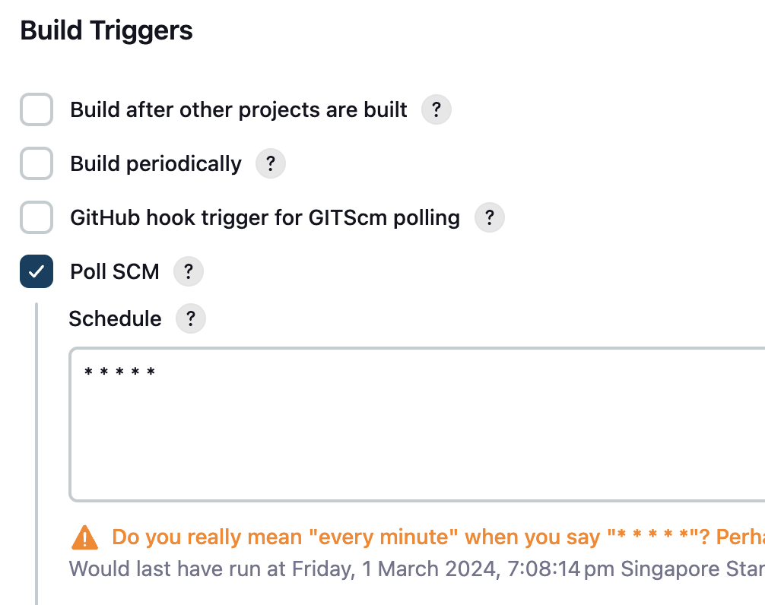
1. Webhook trigger
2. Poll SCM scheduled

Slide 23
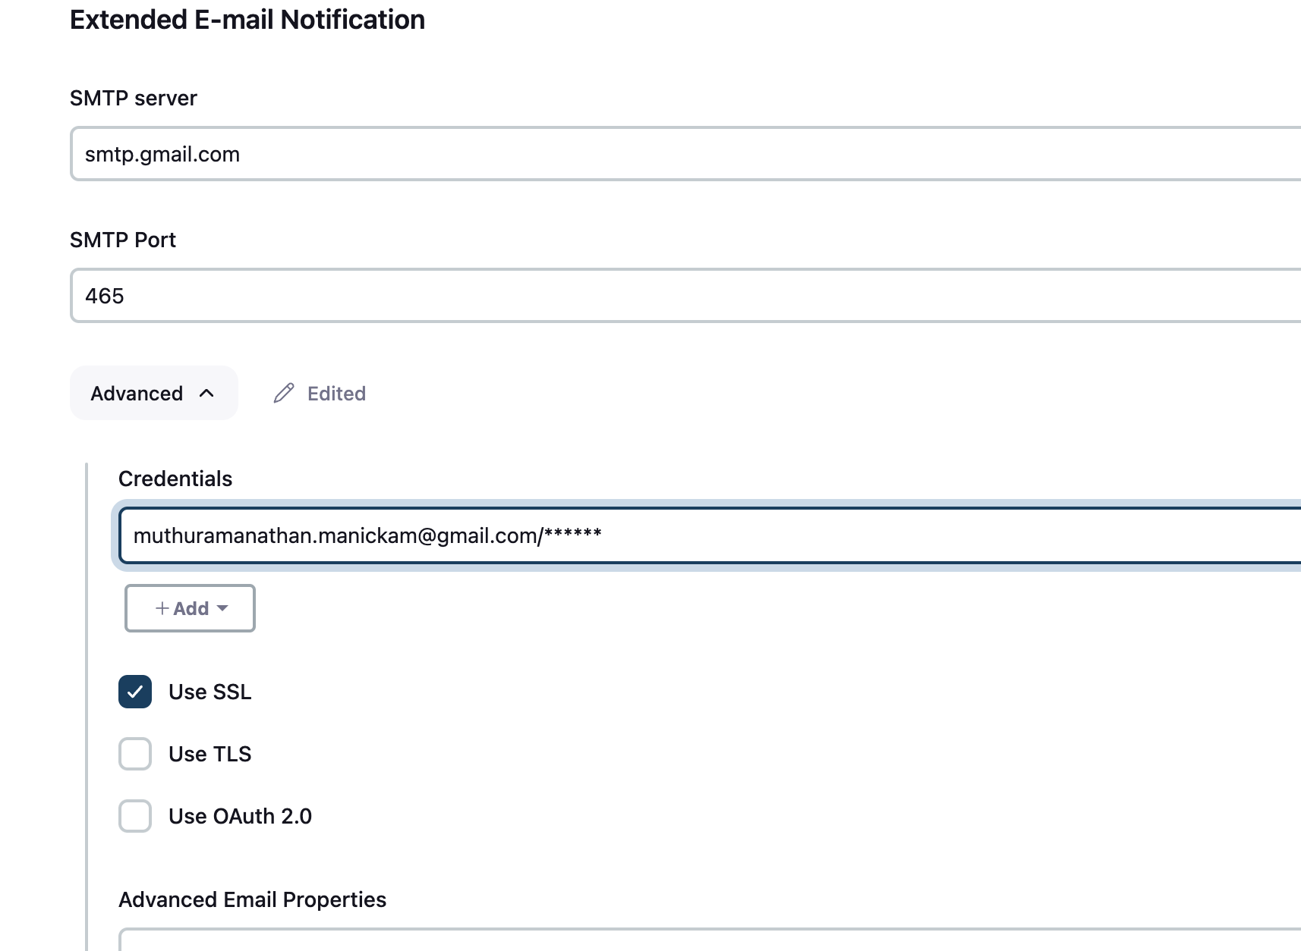
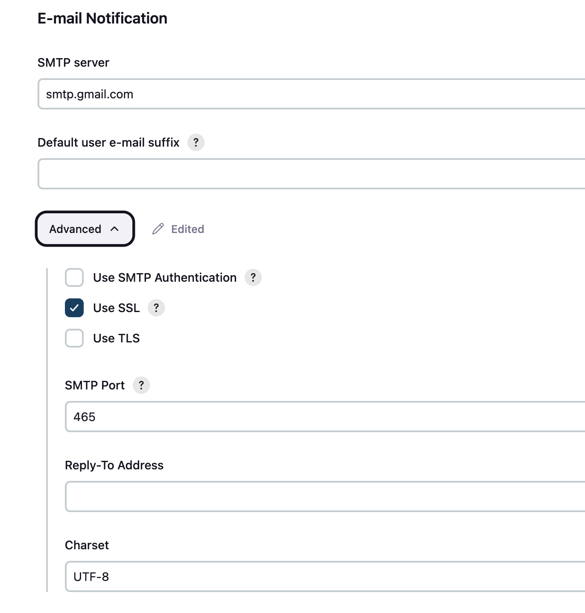
How to send Email from Jenkins:
Make sure ”Email Extension Plugin” installed in Jenkins.
Make the below configuration Manage Jenkins -> System -> Email Extension Plugin option as below
SMTP server – smtp.gmail.com
SMTP Port – 465
Advanced option -> Need to create usrname and App password(gmail)

Slide 24
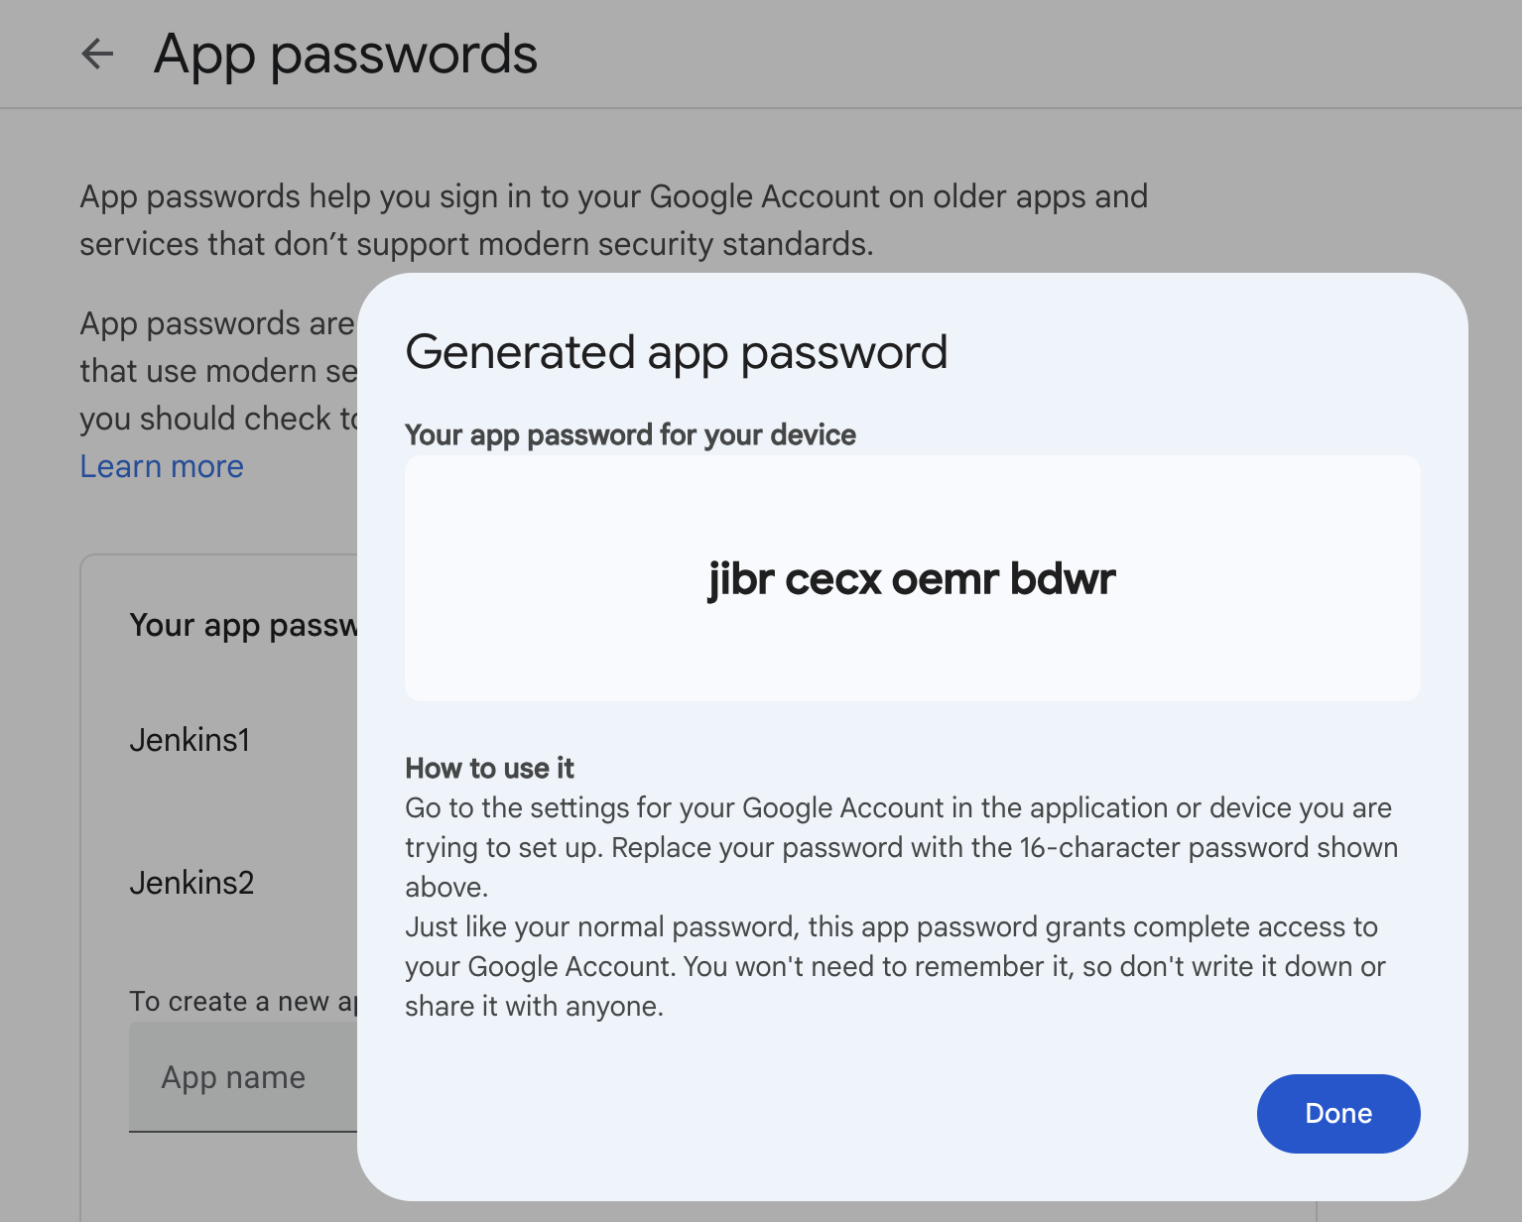
How to create App password in Gmail account
Go to Manage account -> choose security(in the left panel)
Click on 2-step verification -> click on App Password(at bottom)
Enter App name and create . It generate the App password

Slide 25
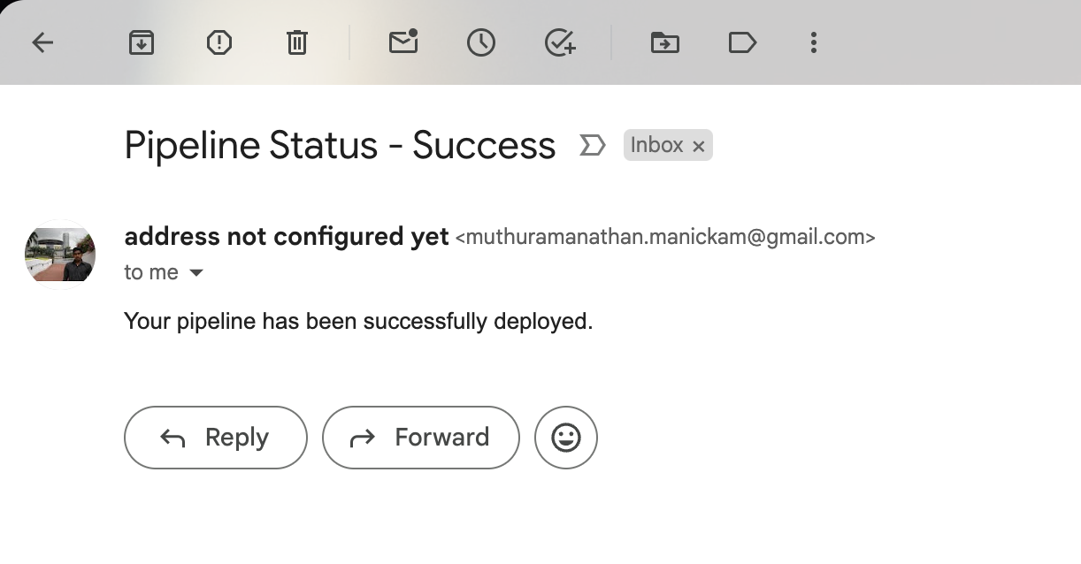
Once everything changed and click on save.
Trigger the build. Now we should be able to receive the email notification to the email.

